Slide 1
E-commerce blockchain
Report by: Praneeth J

Slide 2
True Market
Background
True Market Private Limited is an e-commerce company, headquartered in and incorporated in Singapore.
Capabilities
They provide the technology infrastructure and marketing reach to help merchants, brands, retailers and other businesses to leverage the power of new technology to engage with their users and customers and operate in a more efficient way.
Mission
The company mission is to make it easy to do business anywhere
They also empower enterprises with our leading cloud infrastructure and services and enhanced work collaboration capabilities to facilitate their digital transformation.

Slide 3
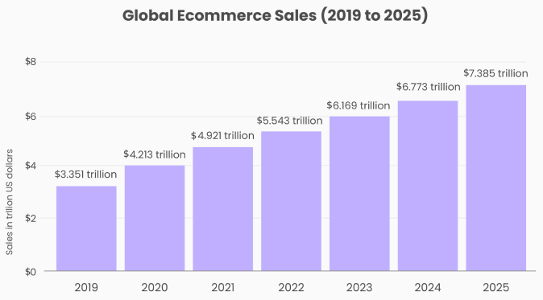
E-commerce
E-commerce platform is a online marketplace and it refers to online shopping – buying and selling goods on the internet.
Ecommerce is often used to refer to the sale of physical products online, but it can also describe any kind of commercial transaction that is facilitated through the internet.
The eCommerce businesses is categorised into four segments based on participants involved in the transaction Business to Consumer (B2C)
Business to Business (B2B)
Consumer to Business (C2B)
Consumer to Consumer (C2C)
Image source : e-Marketer
Customers from other countries enjoy wide range of varieties available in consumer goods , because the sale of goods is beyond geopolitical frontiers from the place of origin of a firm.

Slide 4
Business Drivers
Expected Business drivers Business drivers for digital commerce will include supply chain solutions, guided selling directly to customers from major brands and consumer data security. Each of these elements should be featured in your content strategy by ensuring you build consumer trust over the next year.
Collaborations Collaboration like joint ventures,mergers,strategic alliances are deployed for use of Global resources (foreign raw material, machines).
Globalization Also with the demand for foreign products by customers there is a increased potential market share and a global reach.
Untapped market As discussed about global customer demand for few products that isn't being supplied in few countries by any company yet. This provides businesses an opportunity to the global e-commerce platform like True Market be the first platform offering few products which are demand. Finding an untapped market requires observation and an understanding of emerging trends
Process Efficiencies
1.Ensure Transparency in supply chain
4.Connect Your Sales Channels
2.Easy Shipment and fulfilment.
3.Streamline the Checkout Process

Slide 5
Ecosystem: Tier 1
Technology can be utilized in the e-commerce industry to develop a decentralized online buying and selling platform. Blockchain applications & opportunities are discussed for various aspects of e-commerce like Payment, Security, Supply chain, Work automation with Smart contract, Ethical practices for transparency in e-commerce transactions.
Manufacturer/Suppliers will be our tier of the ecosystem.
We observe a lot of fake products supplied in online market place and there are many unethical practices performed by the company to manager their supply chain. It is difficult for customers to check the authenticity of the transaction at each stage of the supply chain. These kinds of malpractices can be curb by the implementation of blockchain technology in managing the supply chain for e-commerce.
The transparency and immutable blockchain will make each stage of the supply chain accountable. It enables customers to track the origin of each product they have purchased.
Thus with use of blockchain technology companies like True Market has improveed their supply chain which will provide a secure, accurate, authentic and reliable platform to track products in transit. Retailers and customers can track their shipment on real-time bases
Handlers , these are master weavers, local boutique in different parts of world.

Slide 6
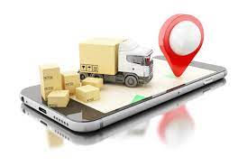
Ecosystem: Tier 2
Block chain enable us to verifiable record from manufacturer to a shipper and shipper to customer.
Shipper can be considered as Tier 2 in this ecosystem.
The ability of blockchain technology to lower shipping costs is one of its main advantages.
Real-time tracking, cargo data visibility, quicker receipts with fewer mistakes, and lower costs are the major features of shipping processes
Blockchain technology may be used in these shipping processes to monitor shipments and packages, which might help the eCommerce industry save money on shipping
Distributed ledger technology allows transportation businesses to trace goods from point A to point B more precisely and effectively, which lowers costs for producers and consumers.

Slide 7
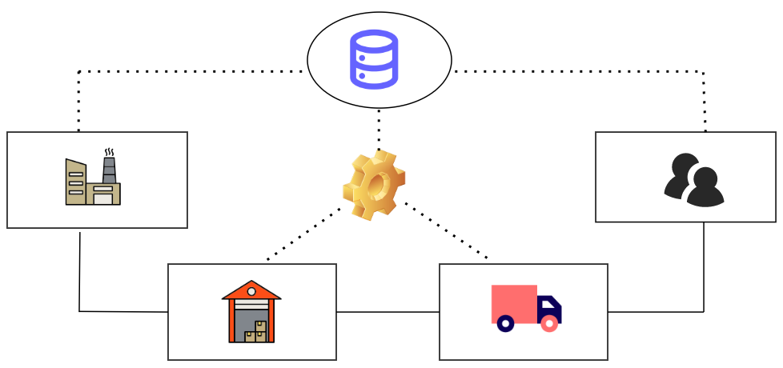
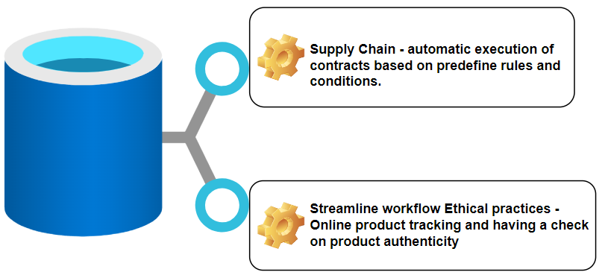
The Business Architecture of E-commerce Blockchain
Centralised data storage mechanism
Manufacturer
Consumer
Warehouse
Shipment
Centralised data storage mechanism

Slide 8
People/Entities
It is difficult for the customer to have a check on the authenticity of transaction at every level of supply chain. Because when a retailer use a poor quality parts and claim it as genuine product or sell inorganic food as organic products then it will difficult for the customer to find the authenticity ,so the kind of malpractices can be curb by the implementation of blockchain technology in managing the supply chain for E-COMMERCE. The transparency and immutable block chain will make each stage of the supply chain accountable .It enable customers to track the origin of each product they have purchased.
Control
Company not only maintaining a record of inventory but it also helps in automated replenishment of inventory. Successful implementation will result in inventory control that is zero out of stock situation for products and thus it will increase the convenience to the customers .
Asset
With the demand for foreign products by customers there is a increased potential market share and a global reach. Global customer demand for few products that isn't being supplied in few countries by any company yet. This provides businesses an opportunity to the global e-commerce platform like True Market be the first platform offering few products which are demand
Economics
The ability of the blockchain technology to lower shipping costs is one of its main advantages.
Since shipping costs are one of the major barriers to online shopping ,this might have a high effect on the ecommerce sector.
Technical
By adopting distributed ledger ,company gain a transparency into shipment tracking, deliveries and progress among other suppliers where no inherent trust exists. Real time tracking cargo data visibility will be the major feature of shipping process.

Slide 9
Blockchain Architectural Framework
Business
Data
Applications
Technology
The emergence of blockchain has already begun to alter the e-commerce sector, and in the next years, it will radically change the environment of online buying. By removing intermediaries and streamlining the process.
Advantages
Ensuring Transparency in the Supply Chain
Blockchain Can Reduce Shipping Costs
Ethical Practices
Security
Improve Security for Customers’ Data
Blockchain improves data use management by extending the potential to convert insights into irreversible assets like
The application of block chain in ecommerce helps us to develop a decentralized online buying and selling platform. Blockchain applications & opportunities are discussed for various aspects of e-commerce like Payment, Security, Supply chain, Work automation, Ethical practices for transparency in e-commerce transactions
Blockchain technology may be used in these shipping processes to monitor shipments and packages, which might help the eCommerce industry save money on shipping

Slide 10
C
O
N
S
U
M
E
R
The customer thinks a thousand times before purchasing the product. He has questions in his mind whether the product that he is purchasing is fake or not.
So in order to stop the making of fake products ,it is important to bring transparency about the products to the notice of the consumers
The developing presence of fake and risky products in the world is a purpose for the situation and blockchain technology has taken the following step toward its entire demolition
The immutable characteristic of the blockchain provides more security and transparency in the transactions of the proposed system.
This technique is used to watch the supply chain in the market.
P
E
R
S
P
E
C
T
I
V
E

Slide 11
Challenges to Adoption
Consumers might take significant time to understand the process of using blockchain-based e-commerce platforms.
Though are trying to follow ethical practices by delivering the original products from manufacturer to customer but considering a scenario where customer is not happy with the product and had to return ,then the cost of logistics would be triggered and also the product which comes back to warehouse should undergo quality check to make sure the authenticity of the product returned. With the effect of competition many companies would reject return in given time frame if customer is not happy with product so there is a logistic and quality issues arise when customer return the product.
Global laws governing their importation, while delivering products world wide ,we need to mind of laws imported in that region where sometimes few products are banned.

Slide 12
Inference of E-commerce on global market
The eCommerce industry is ever-growing. Here are some notable statistics about the growth of eCommerce businesses:
In 2020, online sales accounted for over 18% of all retail sales worldwide. They are expected to keep growing and reach 21.8% in 2024.
The pandemic resulted in an overall growth of $183 billion in terms of online spending and the figure is predicted to grow to $1 trillion in 2022.
Experts predict that eCommerce will make up 95% of all purchases by the year 2040.
In short, the trend in the eCommerce industry is that it inevitably becomes an inseparable part of many people’s lives.

Slide 13
THANKYOU !!
I have taken a example company (True market) and I have given the scope for ecommerce website in future for its use of block chain.

